Slide 1
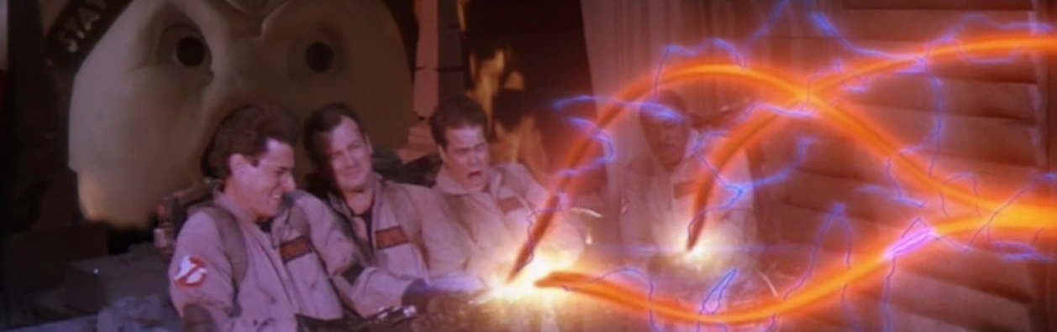
DO Cross the Streams!
Unleash the power of Kafka stream Processors without proton packs

Slide 2
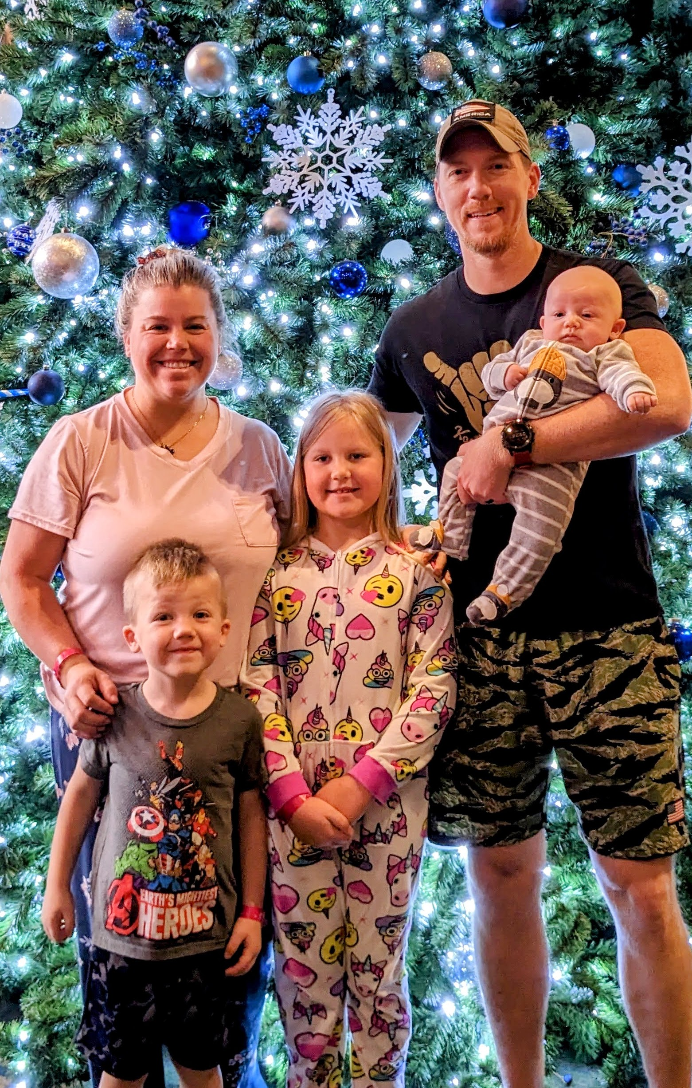
whoami
Josh Castle
Father/Husband/Sr. Consultant, Software Engineer
5th Codemash, 1st Presentation
Nationwide for ~13 years

Slide 3

We are hiring! See our booth!

Slide 4
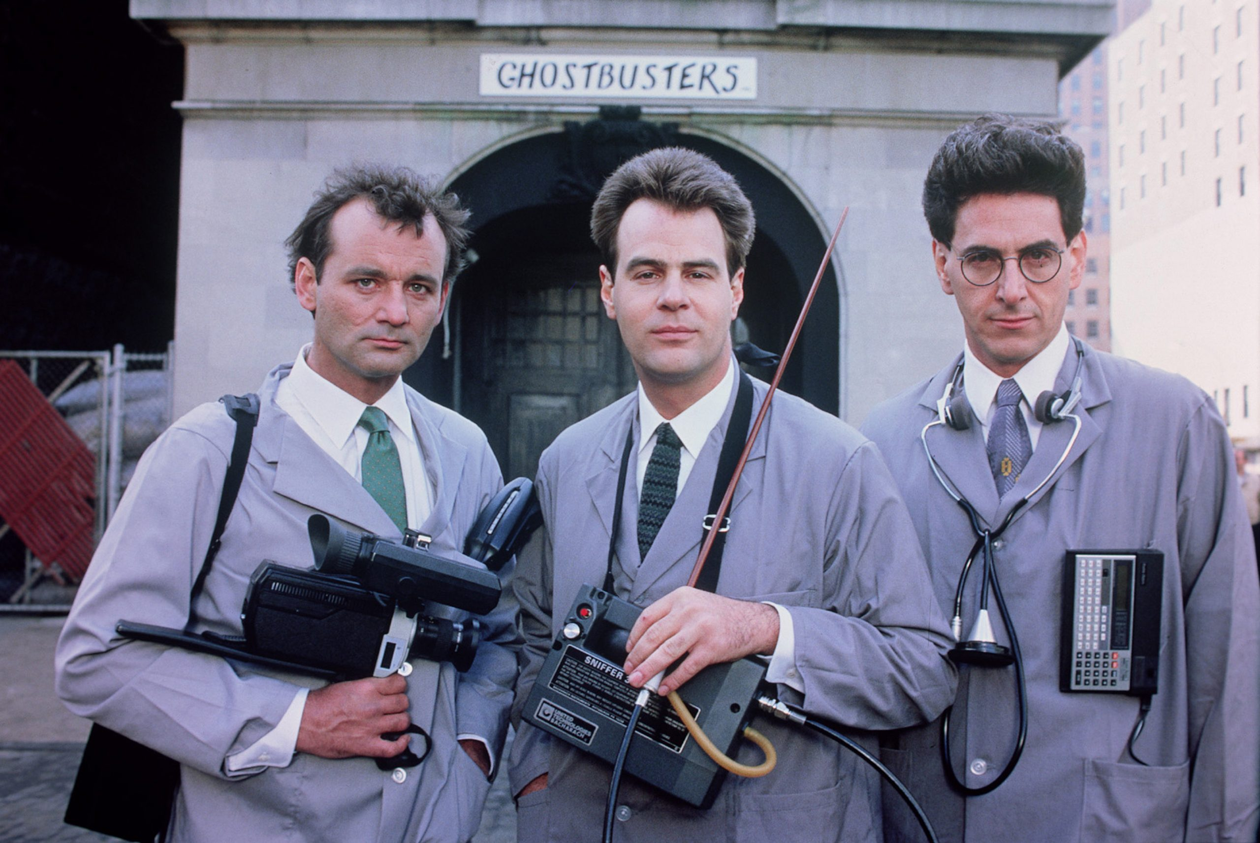
Overview
What is Event Streaming?
What is a Stream Processor?
What is an Event?
Let’s Cross the Streams!
This Photo by Unknown Author is licensed under CC BY-SA-NC
Notes:
Pulse check on:
Who is familiar with event streaming?
Who is familiar with Kafka?
Who is familiar with the Ghostbusters?

Slide 5
What is an event?
An event represents a fact, something happened; and is immutable.
Woke Up
Ate Breakfast
Logged On
Drank Coffee
These things happened and cannot be changed. *
*Assuming time travel is still not available, but Stay Puft Marshmallow Men are.
Notes:
It is fact that these things happened, I can not go back in time to change that.

Slide 6
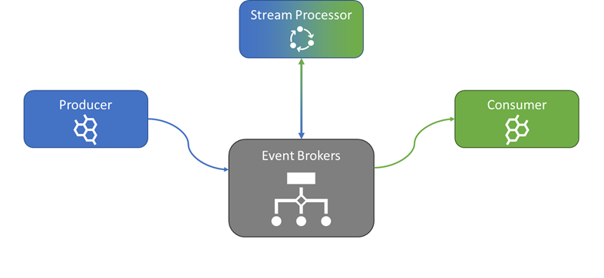

What is event Streaming?
Reads from one stream to filter, transform, enrich, or hydrate into another stream.
Producers publish an event to the event broker.
Consumers read streams of events on demand.
Kafka stores and manages events.
Notes:
Kafka is our broker which is provided in a distributed, highly scalable, elastic, fault-tolerant, and secure manner.
To publish (write) and subscribe to (read) streams of events, including continuous import/export of your data from other systems(sink/source connectors).
To store streams of events durably and reliably for as long as you want.
To process streams of events as they occur or retrospectively.

Slide 7





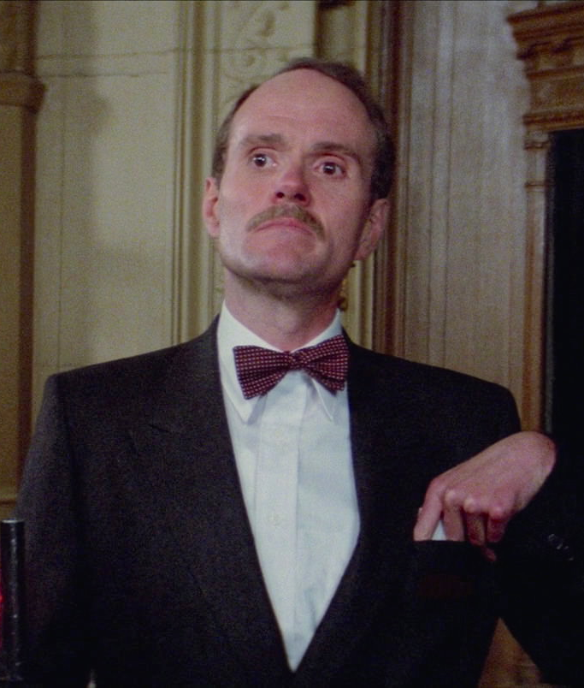
Example Event Stream
Property Haunted
Ghost Busted
Bill Mailed
Producers
Event
Stream
1
2
3
Consumers
Ghostbusters Sent to Scene
Janine Sends Documents
Hotel Begrudgingly Pays
Notes:
Events happen in a repeating fashion is called an event stream. Events are fired off and the producer goes on with their day, consumers pull from the stream at their own speed.

Slide 8

How Event Streaming Works
E
E
E
E
E
E
Event Broker
Consumer
Consumer A
Producer
Topic
Activity
1
2
3
4
5
6
E
E
E
E
B
A
Consumer B
Key Takeaways:
Events are created based on activities completed within the Producer
Events are immutable and appended to the end of the stream
Topics can have many consumers who read the Events from the Topic
Each Consumer maintains its own pointer (offset) in the Topic
Notes:
Queue vs Stream
Queue – targeted at a consumer, FIFO, deletes messages, typically batch
Stream – events published around a domain for real time processing by multiple consumers, immutable.
Replay

Slide 9

Stream Processing
What can it do?
Detecting Patterns
Filtering Events
Aggerating Events
Transforming Events
Building Event Hierarchies
Detecting Relationships between Events
How Does it Work?
Event Broker
Producer
E
Topic A
Stream Processor
E
Topic B
https://medium.com/stream-processing/what-is-stream-processing-1eadfca11b97
Notes:
Event Processing enables events to be acted on in “real-time” for discovering new insights and patterns.

Slide 10
Why Stream processing?
Encourages good streams designs
Not tailored for a single consumer, but published for everyone
Consumer specific logic to live with the consumer
Add additional data to a stream
Filter out events you don’t care about as a consumer
Join streams
Split streams out
Notes:
https://www.confluent.io/blog/introducing-kafka-streams-stream-processing-made-simple/

Slide 11
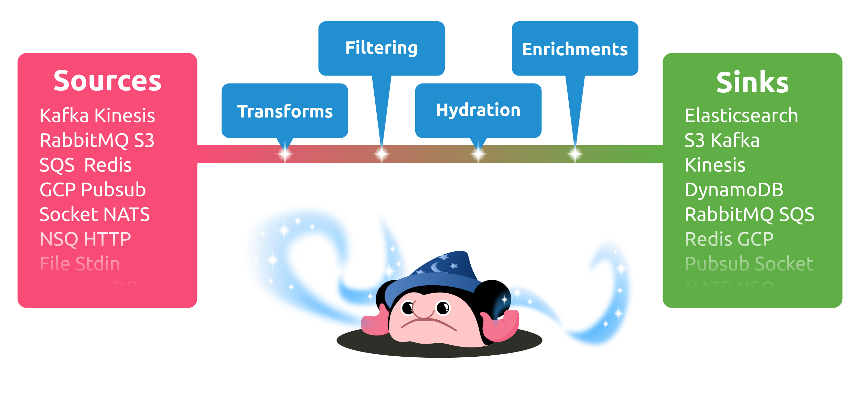
Benthos
Benthos is a declarative data streaming service that solves a wide range of data engineering problems with simple, chained, stateless processing steps. It implements transaction based resiliency with back pressure, so when connecting to at-least-once sources and sinks it's able to guarantee at-least-once delivery without needing to persist messages during transit.
https://v3.benthos.dev/docs/about

Slide 12
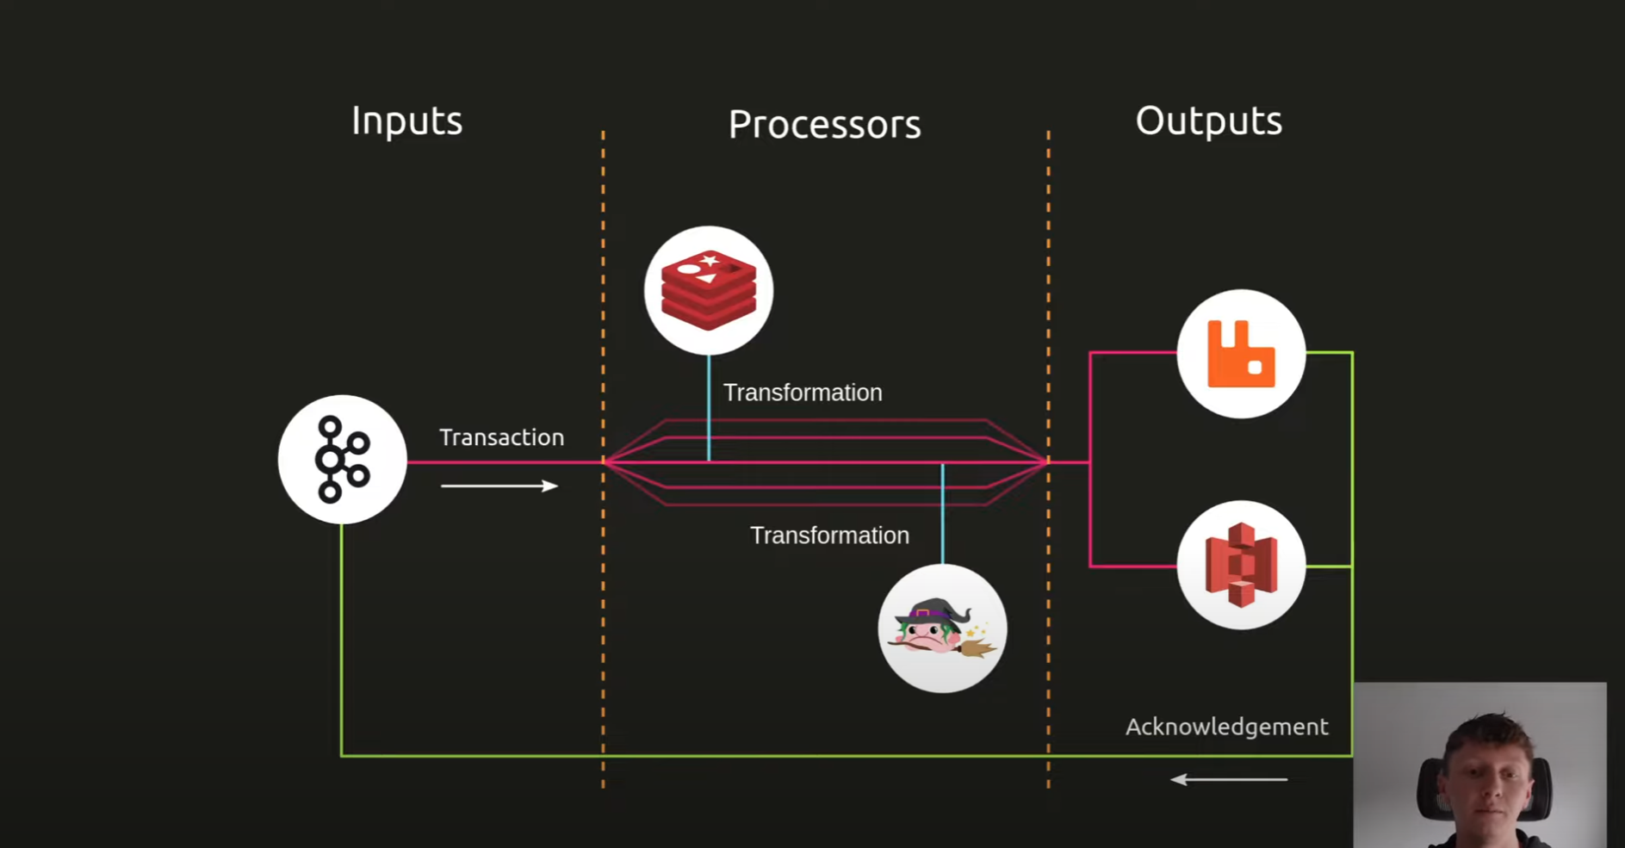

Anatomy of Benthos
Ashley Jeffs
Creator of Benthos
This Photo by Unknown Author is licensed under CC BY-NC

Slide 13
Benthos Benefits
Declarative - config over code
“Cloud native as utter heck”
Reduction of cycles needed within an application
Lots of power within a small number of YAML lines of config
Notes:
Waits to commit offset when it consumes until after it has produce the message to the new stream

Slide 14
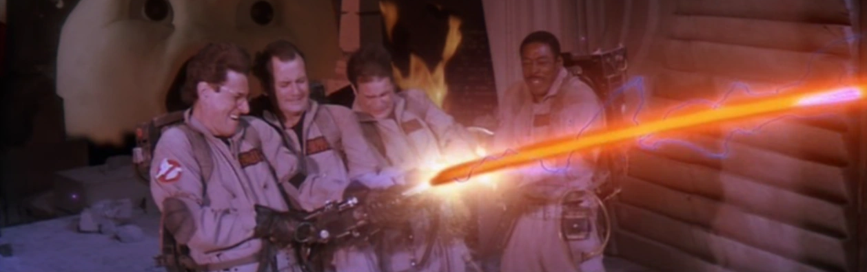
Time to cross the streams!
Notes:
https://github.com/joshcastle/CodemashStreamProcessors/tree/main/benthos

Slide 15
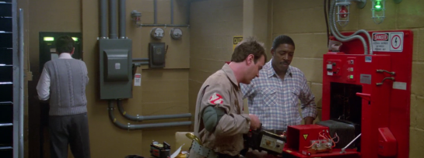
Additional Resources
Demo Walkthrough
Benthos
Confluent Developer Learning

Slide 16

Thank You!
castlej6@nationwide.com
Todays Demo:
bit.ly/crossTheStreams

